Slide 1
PYTHON PROJECT
Text editor

Slide 2
Introduction
A text editor is program that allows you to open, view, and edit plain text files.
The text editor which is used to write the information and we can change the fonts,colours and etc..,
By the text editor we can replace the word or we can find particular word from the information.

Slide 3
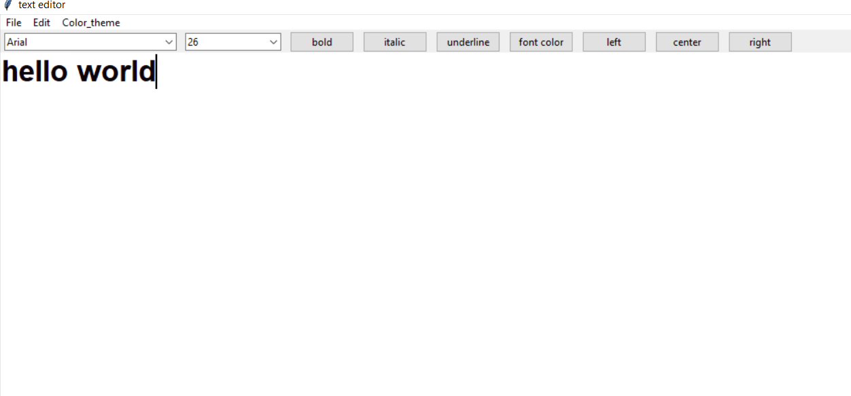
Interface of the text editor:

Slide 4
Modules used in the code:
Tkinter module:-Is standard GUI library for python. python when combined with tkinter provides easy way to create a GUI applications.
TTK module:-The ttk module provides access to the tk themed widget set.
Font module:-As a tuple whose first element is the font family, followed by a size in points, optionally followed by a string containing one or more of the style modifiers bold, italic, underline and overstrike.
Filedialog module:-File dialog help you open, save files or directories. This is the type of dialog you get when you click file,open.

Slide 5
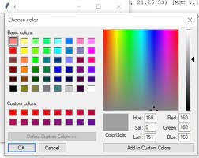
Colorchooser module:-This function belongs to the colorchooser package of tkinter module. The function helps in creating a color chooser dialog box.
OS module:- The main purpose of the OS module is to interact with your operating system. The primary use I find for it is to create folders, remove folders, move folders, and sometimes change the working directory.

Slide 6
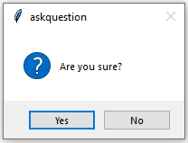
Messagebox module:-MessageBox Widget is used to display the message boxes in the python applications.

Slide 7
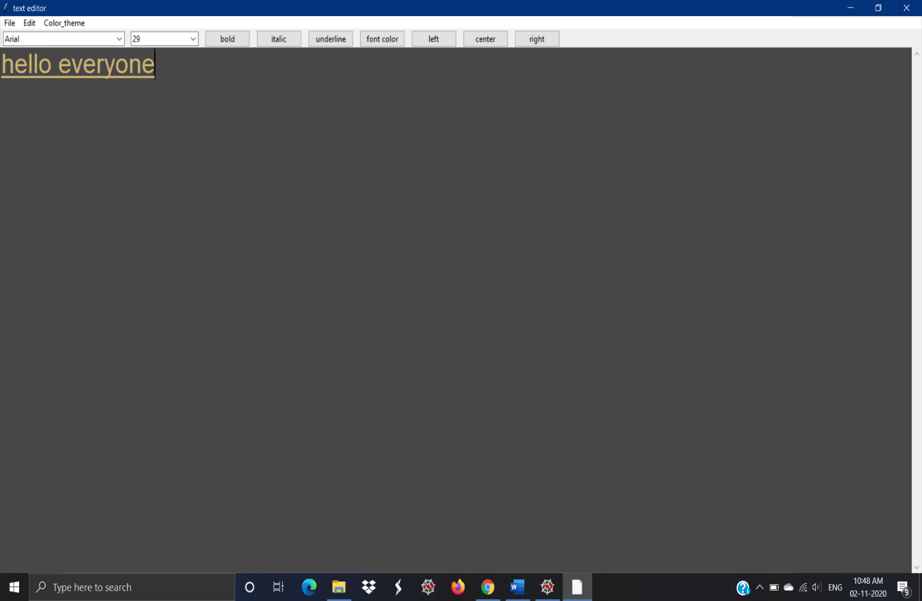
Important:
With monokoi color theme and
underlined text

Slide 8
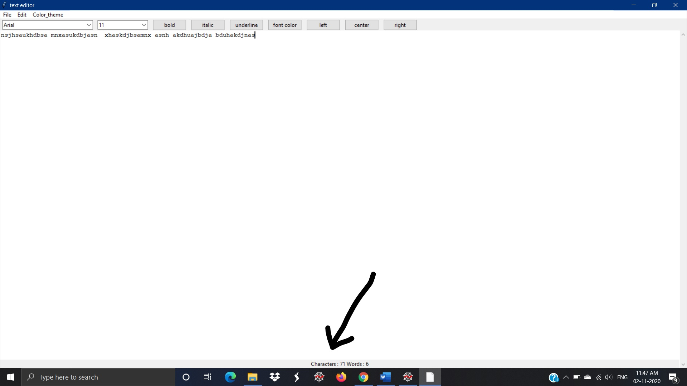
With status bar which is calculating words and characters user have written on the file

Slide 9
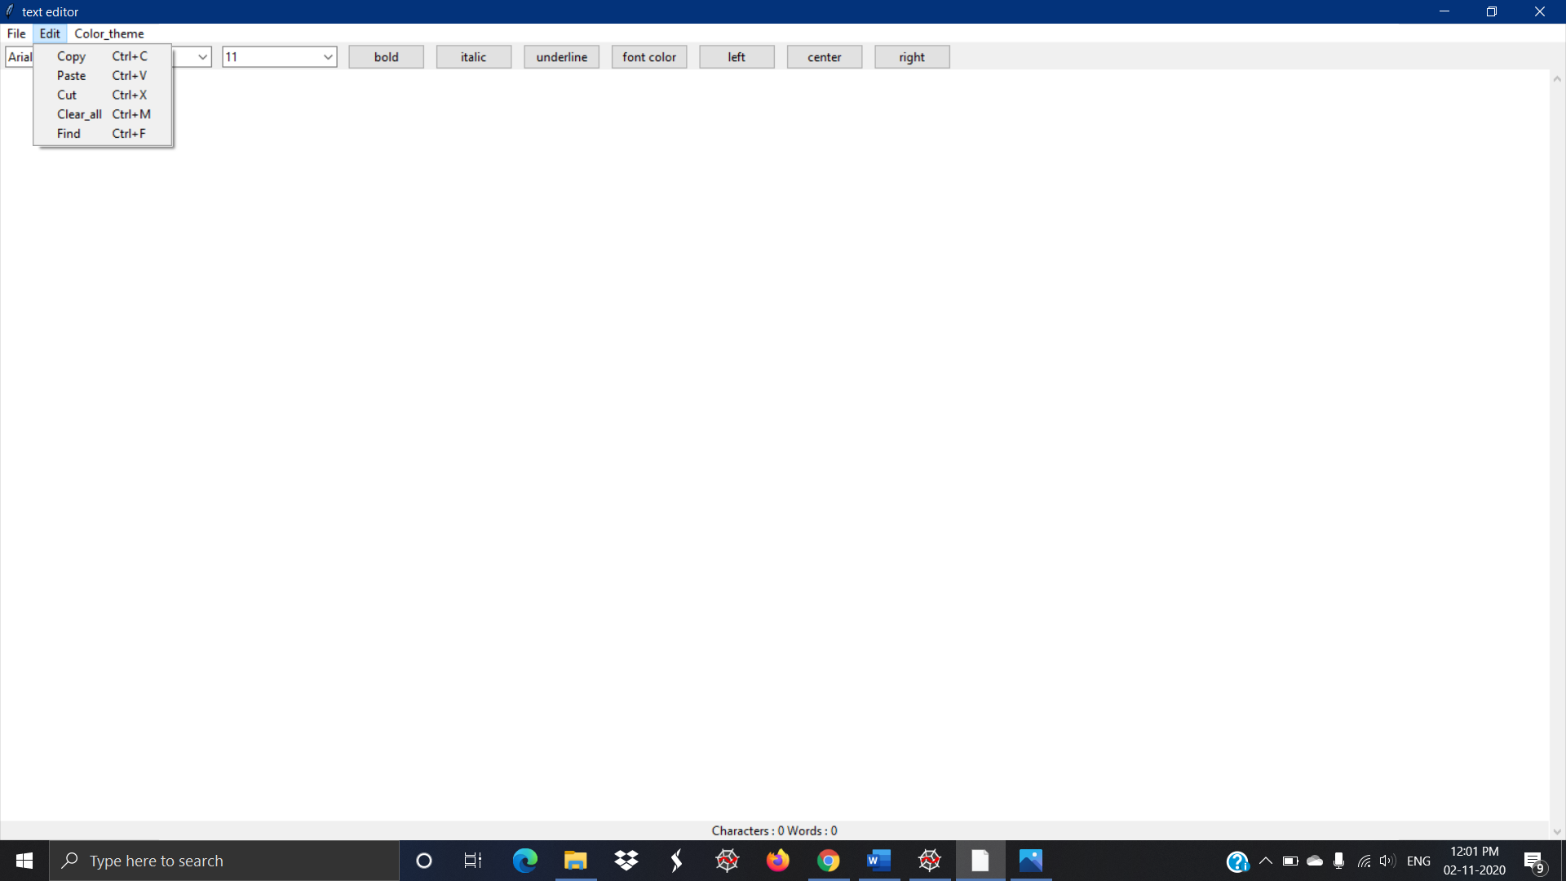
With the edit option which includes copy, paste, cut, clear, find

Slide 10
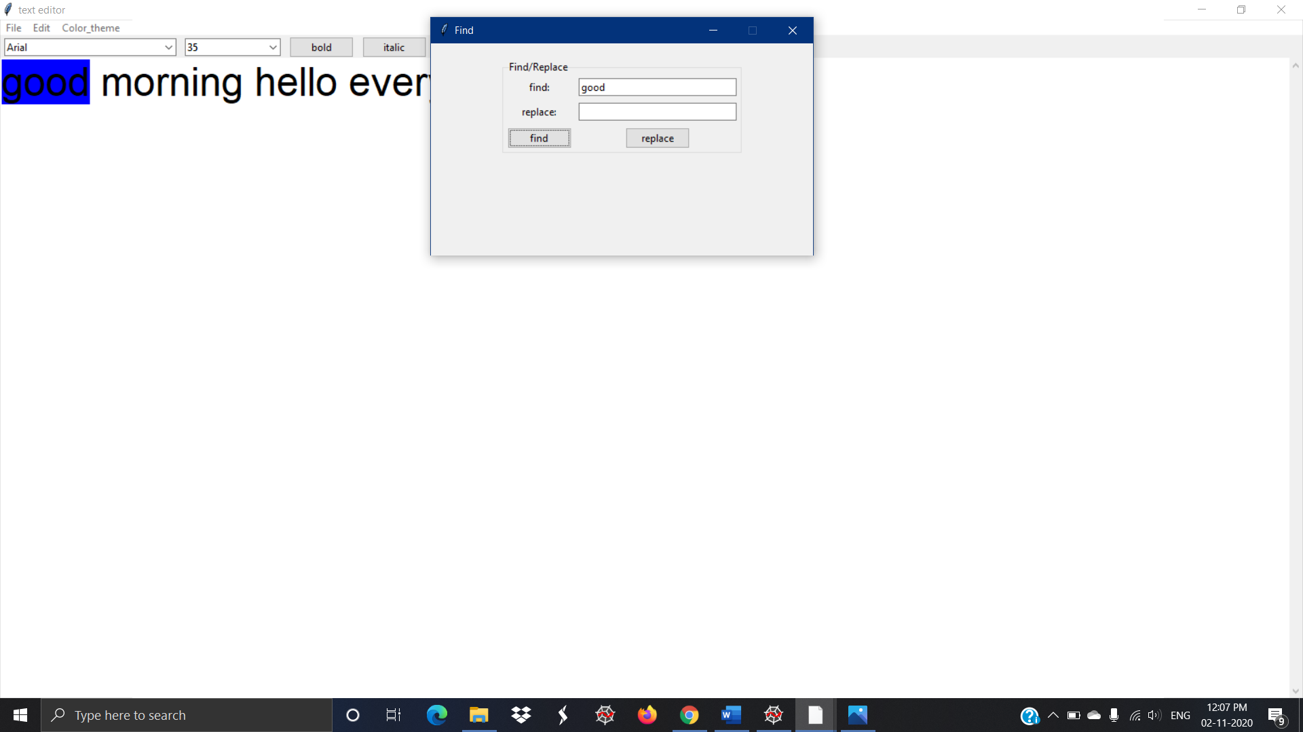
With the find option which can search the word and also it can replace that word throughout the file

Slide 11
Conclusion:
The text editor gives us a simple and reliable way to create, save, open and so many options. It provides functionalities to edit, clear, cut, copy, paste, find, replace, change theme change text color, change text size and many more. The experience of making this project also helped us learning a lot of tkinter and its different modules and functions.
. Once this project passes the testing phase and after developing it with some more functionalities, it can be used for students and also for others. It will make the work much easier. It also can simplify the work for students with reports, submission all in one system.
However, even if that happens, the flexibility of tkinter would provide a simple way to fix the problem, as well as add new features into the project.

